Slide 1
Module 11: Modeling Time Series Data
Analytics: Server Architect (Siebel 7.7)
Notes:
Time: Lecture: approximately 40 minutes; labs: See Lab Guide for timings.
Intent: Describe time comparison measures and implement time comparison measures using the Time Series Wizard to compare dollar performance with a previous time period.
Flow: Concepts are described and then using the wizard is explained in the context of an ABC example.
Key Terms:
Time comparisons
Time series data
Time Series Wizard
11

Slide 2

Module Objectives
After completing this module you will be able to:
  Describe the use of time comparisons for business analysis
  Implement time comparison measures in the business model using the Time Series Wizard
Why you need to know:
  Time comparisons allow you to compare current versus past performance and enable trend analysis
  The ability to compare business performance with previous time periods is fundamental to understanding a business
Notes:
Each objective and “why you need to know” should be stated aloud.

Slide 3
Time Comparisons
Analyze data spanning multiple time periods
Give context to information
Example: Compare this year’s sales and last year’s sales
Sales – This Year
Sales – Last Year
How do they compare?
Notes:
The ability to compare business performance with previous time periods is fundamental to understanding a business. For example:
Question: What are sales so far this year?
Answer: $50,000,000
Question: Is that good?
11

Slide 4
Time Comparisons Continued
Need to ask three different questions to get the result
Question 1:
What was this year’s sales?
Question 2:
What was last year’s sales?
Question 3:
How do they compare?
Notes:
To answer the question, “Is that good?” you need the answer to the three questions asked on this slide.

Slide 5
Business Challenge: Time Comparisons
SQL is not designed with business analysis in mind
  There is no direct way in SQL to compare this year to last year
Query 1:
What was this year’s sales?
Query 2:
What was last year’s sales?
Requires three different queries to get the result
Query 3:
How do they compare?
Notes:
SQL was not designed to make comparisons over time in a straightforward manner. “SQL was not designed with business reports in mind. SQL was really an interim language designed to allow relational table semantics to be expressed in a convenient and accessible form, and to enable researchers and early developers to proceed with building the first relational systems in the mid-1970s. How else can you explain the fact that there is no direct way in SQL to compare this year to last year?” Ralph Kimball
11

Slide 6
Solution: Time Comparisons
Model time series data in the Siebel Analytics repository:
  Allow users to make one request for the desired result
  Run multiple queries in parallel to get the results
Query 1:
What was this year’s sales?
User makes one request for all three queries using time comparison measures
Query 2:
What was last year’s sales?
Query 3:
How do they compare?
Notes:
The queries that run in the background to support the time measure are transparent to the user.

Slide 7
ABC Example
ABC wants to compare performance against performance in previous time periods to monitor its business
Implement new measures in the business model to compare dollar performance to a year ago
  Show change in dollars
  Show change as percentage
  Example:
In 1999, dollars increased in the central region compared to the previous year
It was a change of 2.83%
Notes:
Users will be able to select columns that show this year’s dollar performance compared with last year’s dollar performance and calculate the percent of change.
11

Slide 8
Solution: Time Series Wizard
Is a utility of the Analytics Administration Tool
Automates the process of modeling time series data
Guides you through a series of prompts to model comparison measures
Notes:
The Time Series Wizard automates the process of creating measures and calculations to support historical time comparison analyses. The Time Series Wizard guides you through a set of prompts that automates the process to model comparison measures. These comparison measures enable derived analysis rather than pre-generating and storing the data.

Slide 9
Steps to Model Time Series Data
0/6
Examine physical sources
Start Time Series Wizard
Name comparison measures
Select period table
Select period table key
Select measures and calculations
Notes:
This is a structuring slide. Do not teach the steps or concepts here because the following slides cover them in detail. Provide a high-level description of what will be discussed.
11

Slide 10
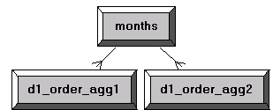
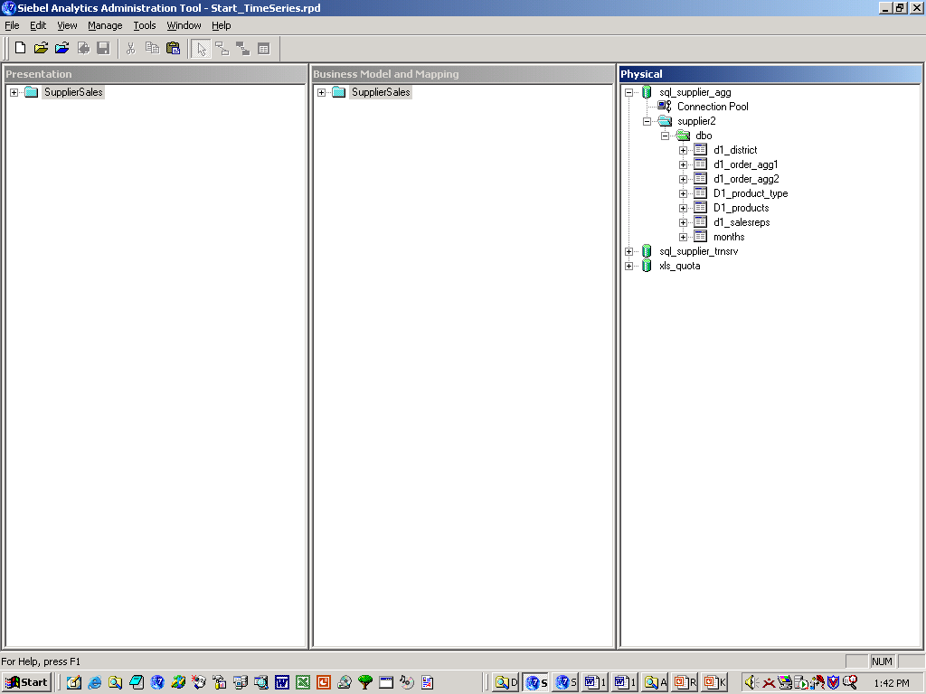
1. Examine Physical Sources
1/6
Identify time periods you want to compare
Identify the period table for keys to the previous time periods
The months period table contains the YAGO column with the keys to the year-ago totals
These two fact tables contain aggregates of the year-ago totals
Notes:
The Physical layer must have a period table available. In this example, months is a period table that contains a column that stores the keys to the dollar totals for a year ago in two fact tables (d1_order_agg1 and d1_order_agg2 in this example).

Slide 11
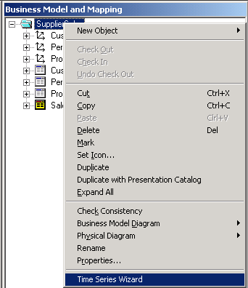
2. Start Time Series Wizard
2/6
Right-click the business model and select the Time Series Wizard menu option
Notes:
It is recommended that you use the right-click menu to start this wizard because it typically takes less time to open using this method.
11

Slide 12
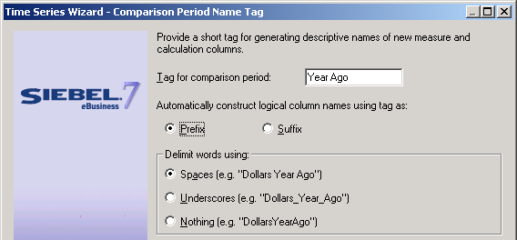
3. Name Comparison Measures
3/6
The Time Series Wizard prompts you to create names for the comparison measures that it adds to the business model
Year Ago will be added as a prefix to the new measures
Notes:
The wizard prompts you to specify a tag (Year Ago in this example) that becomes a prefix or suffix to the measures (logical columns) that are created by the wizard.

Slide 13
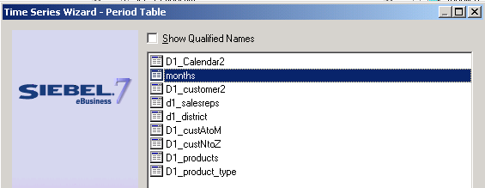
4. Select Period Table
4/6
The Time Series Wizard prompts you to select the period table used for the comparison measures
The months table stores the keys to the year-ago totals
Notes:
The wizard prompts you for the period table (months in this example) that is accessed by the new measures.
11

Slide 14
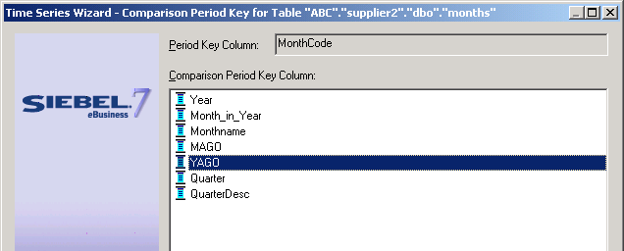
5. Select Period Table Key
5/6
Select the column in the period table that provides the key to the comparison period
YAGO is the column with keys to the year-ago measures
Notes:
The wizard prompts for the column (YAGO in this example) that stores the key to the dollar totals for a year ago.

Slide 15
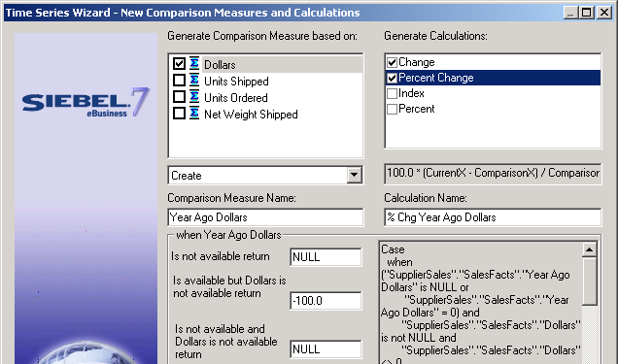
6. Select Measures and Calculations
6/6
Select the measures you want to compare
Select the calculations you want to generate
Dollars is the measure selected for the comparison
Change and the Percent Change of dollars are the calculations
Specify the result you want if the measure returns zero or is not available
Notes:
The wizard prompts for what measure you want to compare (Dollars in this example) and the calculations you want (Change and Percent Change in this example). The wizard also prompts you to specify what value should be returned if the Year Ago Dollars column has no value (is null). This must be specified for the two calculations Change and Percent Change. Select each in turn and specify what value should be returned. You can enter any numeric value or NULL. Do not enter a value that would change the data type. For example, do not enter NA, which is a character value rather than a numeric value. Note this is similar to the Calculation Wizard covered in an earlier module.
11

Slide 16
Times Series Wizard Output
0/4
Aliases for fact tables
Joins between period table and alias fact tables
Comparison measures
Logical table sources
Notes:
This is a structuring slide. Do not teach the steps or concepts here because the following slides cover them in detail. Provide a high-level description of what will be discussed

Slide 17
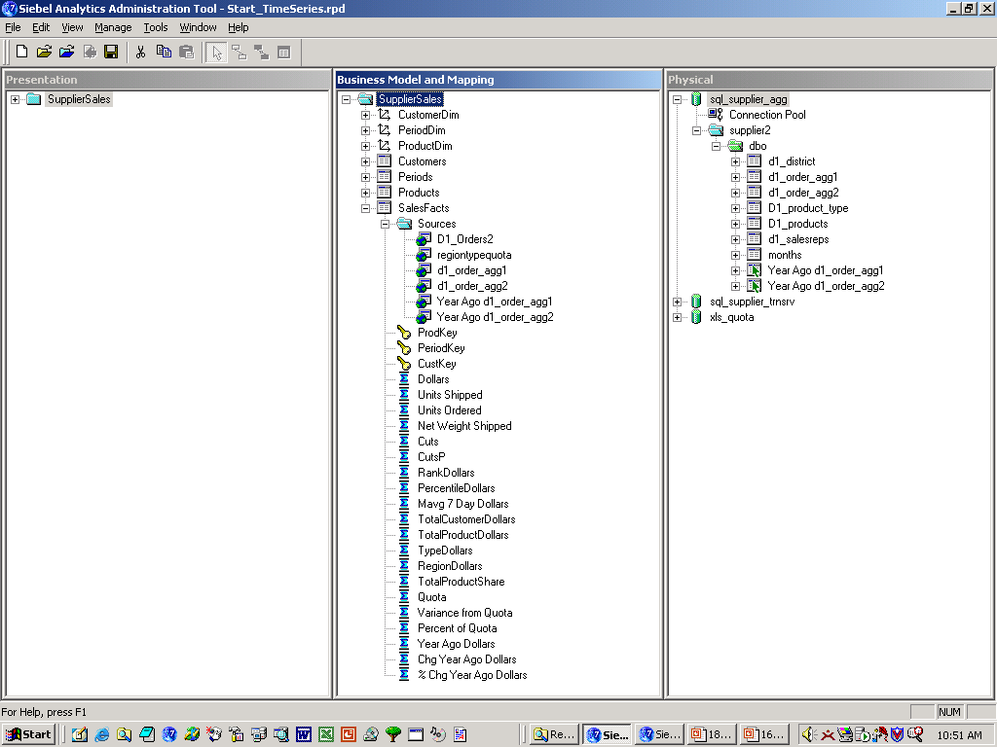
Aliases for Fact Tables
1/4
The Time Series Wizard creates aliases for each physical fact table that is used as a source
Aliases of the two fact tables
These alias tables are identical to fact tables but have a different name
Notes:
In the Physical layer, the wizard has configured two alias fact tables as physical sources for the new comparison measures. These alias tables are duplicates of the fact tables d1_order_agg1 and d1_order_agg2 that store the dollar totals for a year ago (as described on slide 10). The alias tables allow the months table to join two different columns in each of the fact tables (more about the joins in an upcoming slide).
11

Slide 18
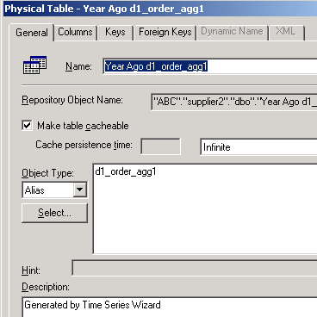
Aliases for Fact Tables Continued
1/4
Properties of the new alias physical table indicate that it was created by the Time Series Wizard
Originating fact table
This alias table was created by the Time Series Wizard
Notes:
You can determine how the alias was created by examining the properties.

Slide 19
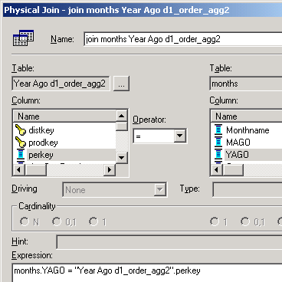
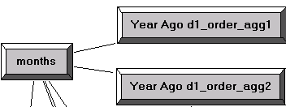
Joins Between Period Table and Alias Fact Tables
2/4
The Time Series Wizard configures joins between the period table and the new alias fact tables
  Joins are complex because YAGO is not the key for the period table
YAGO is the column in the period table with keys to the year-ago totals
Notes:
In the Physical layer, the months period table now joins to two columns in each fact table.
The original joins between the months table and the two fact tables are:
months.MonthCode = d1_order_agg1.perkey
months.MonthCode = d1_order_agg2.perkey
The new joins configured by the wizard between months and the two alias fact tables are:
months.YAGO = "Year Ago d1_order_agg1".perkey
months.YAGO = "Year Ago d1_order_agg2".perkey
The joins between the months table and the two alias fact tables are complex since the YAGO column is not the key for the months table.
11

Slide 20
Comparison Measures
3/4
The Time Series Wizard adds comparison measures (new logical columns) to the fact table
Comparison measures added to the fact table
Notes:
In the Business Model layer, the wizard has configured three new comparison measures (logical columns) in the fact table:
Year Ago Dollars
Chg Year Ago Dollars
% Chg Year Ago Dollars

Slide 21
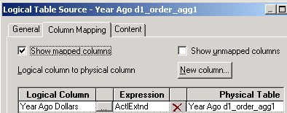
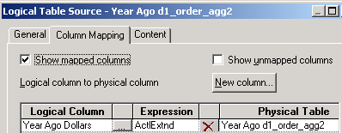
Logical Table Sources
4/4
The Time Series Wizard adds logical table sources to the fact table that maps the comparison measures to the physical tables
New logical table sources map the comparison measures to the physical sources
Notes:
The wizard has also configured new logical table sources in the SalesFacts logical table for the new columns. The new columns are mapped to the two alias fact tables in the Physical layer.
11

Slide 22
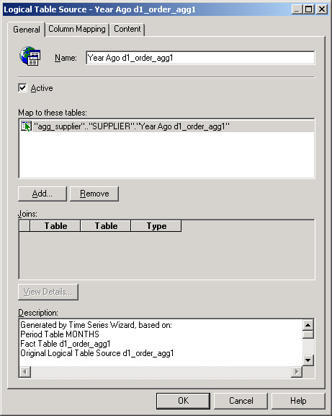
Logical Table Sources Continued
4/4
Properties of the new logical table sources indicate it was created by the Time Series Wizard
Originating period table and fact table information

Slide 23
Testing the Repository Changes
0/2
1. Add comparison measures to presentation catalog
2. Test comparison measures
Notes:
This is a structuring slide. Do not teach the steps or concepts here because the following slides cover them in detail. Provide a high-level description of what will be discussed
11

Slide 24
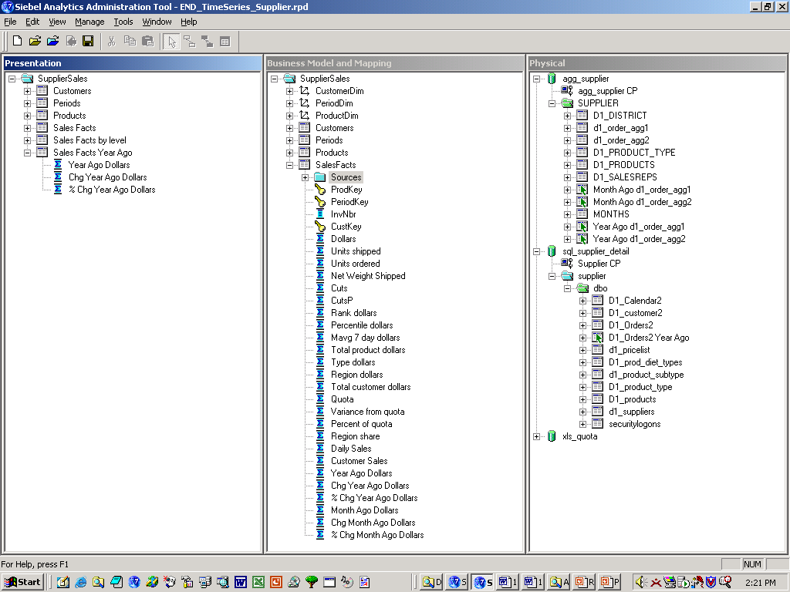
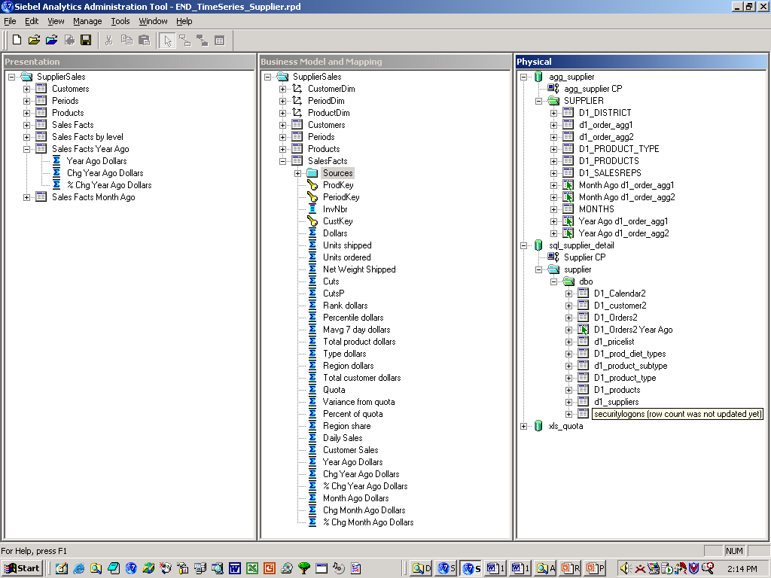
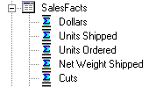
1. Add Comparison Measures to Presentation Catalog
1/2
Drag the new comparison measures to the presentation catalog in the Presentation layer
Notes:
To make the new comparison measures available to users in Siebel Answers, drag them to the SalesFacts presentation table in the Presentation layer.

Slide 25
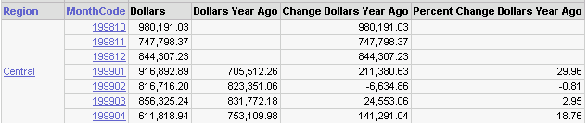
2. Test Comparison Measures
2/2
Use Siebel Answers to test the new measures
Change Dollars Year Ago returns the difference in dollars sold compared to the previous year
Since there is no data for 1997, Percent Change Dollars Year Ago returns NULL as specified in the wizard
Notes:
11

Slide 26
Summary
This module showed you how to:
  Describe the use of time comparisons for business analysis
  Implement time comparison measures in the business model using the Time Series Wizard
Notes:
Review Questions:
Question: When analyzing business performance, what is the purpose of time comparisons?
Answer: Time comparisons analyze data spanning multiple time periods and give context to information.
Question: What three answers are needed to compare this year’s sales with last year’s sales?
Answer: What was this year’s sales? What was last year’s sales? How do they compare?
Question: There is no direct way in SQL to compare this year to last year. True or false?
Answer: True.
Question: What does modeling time series data (comparison measures) in the Siebel Analytics repository allow users to do?
Answer: It allows users to make one request in Siebel Answers for their desired result while multiple queries run in parallel to get the results.

Slide 27
Lab
In the lab you will:
  Create comparison measures to compare dollar performance from previous time periods
  Use the Time Series Wizard to create the time comparison measures
Notes:
Labs and Troubleshooting:
See Lab Guide for details.
11

